Slide 1
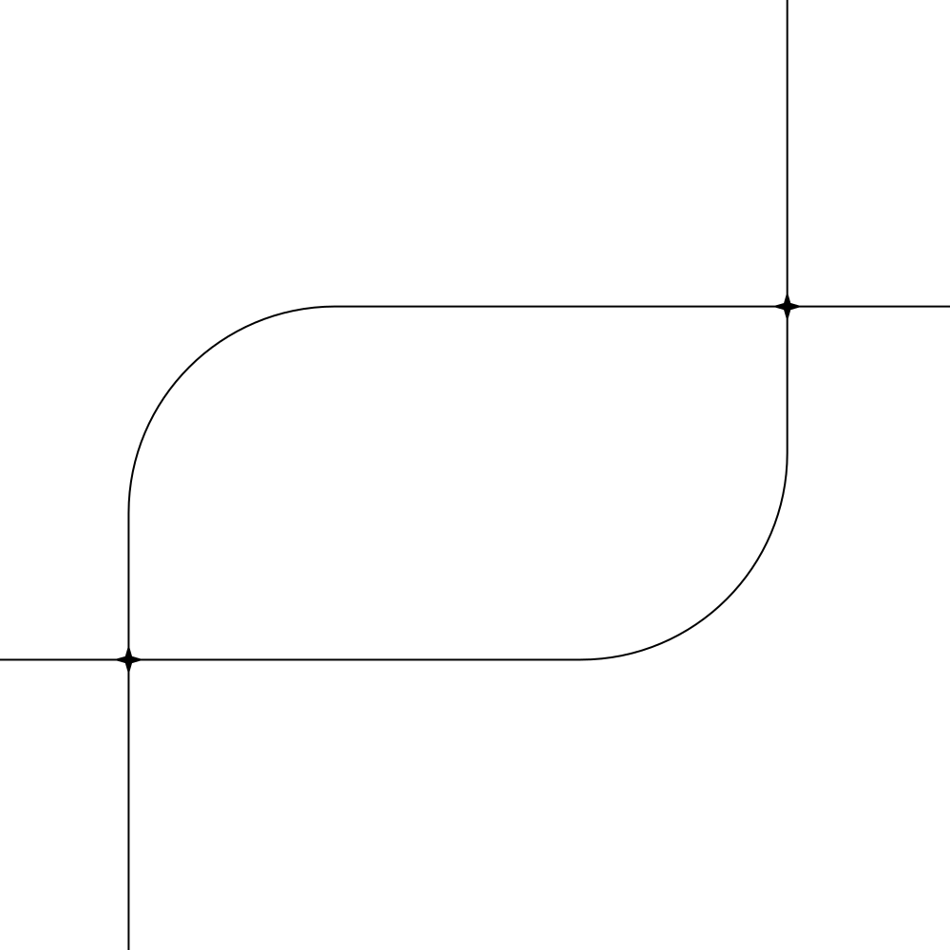
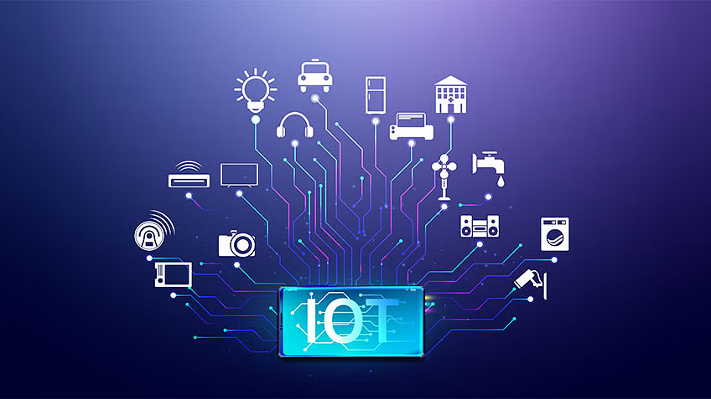
EIU
IOT
by Aram Al-Shahateet
supervision:
Ms. Doaa Ghanayem

Slide 2

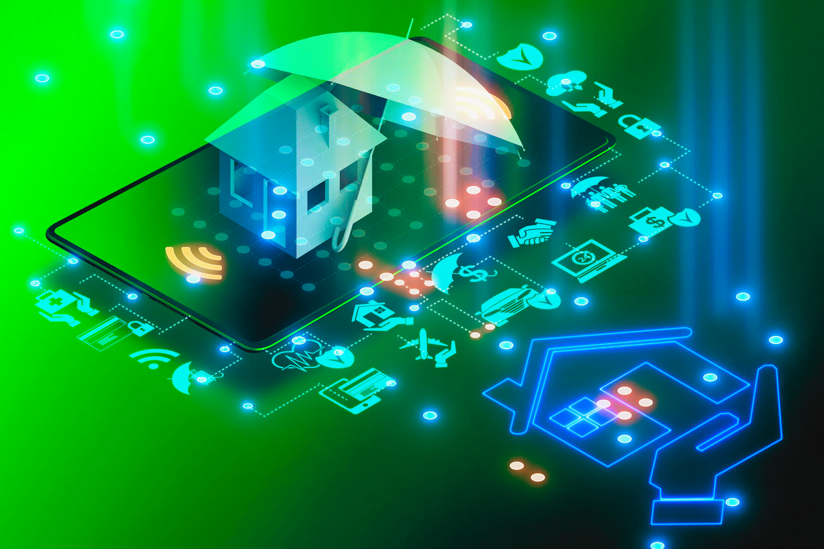

Imagine a World Where Your Home Thinks for Itself

Slide 3

OVERVIEW
what is IOT ?
Challenges and Concerns
Why IOT ?
Future of IOT
How IOT Works
IOT

Slide 4
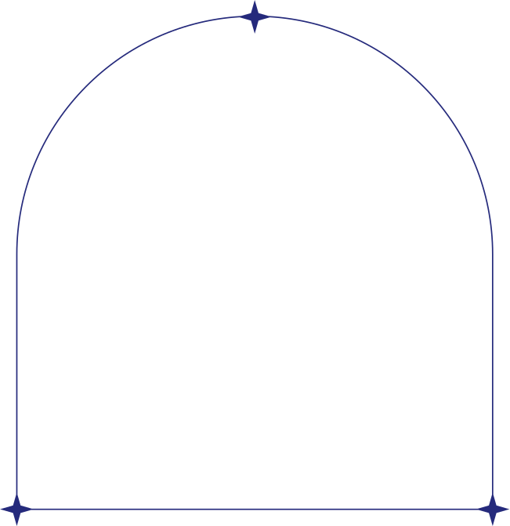

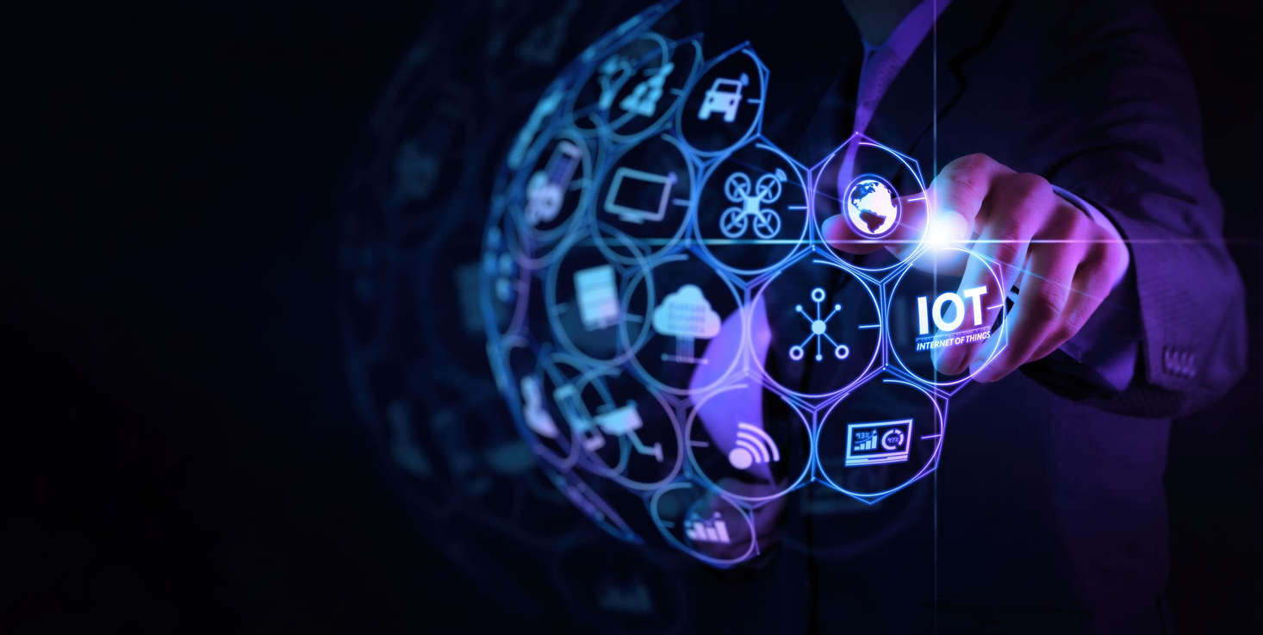
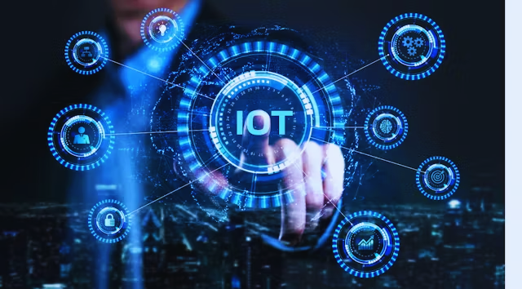
what is IOT ?
Definition
Purpose
Applications of IoT

Slide 5
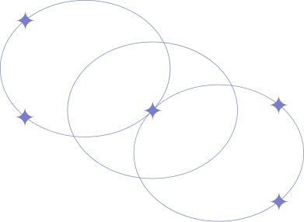
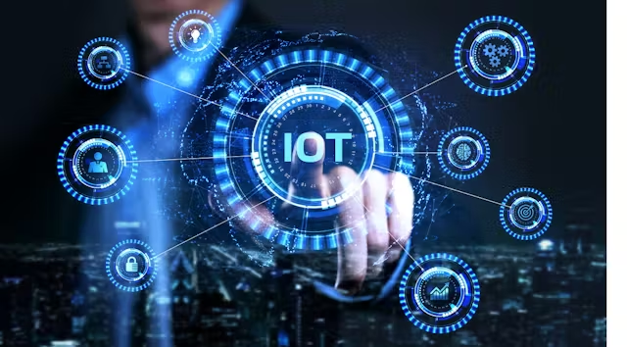
Why IOT ?
We’re a bit lazy!
We want to automate everything!
We want remote control!
We want real-time data!

Slide 6
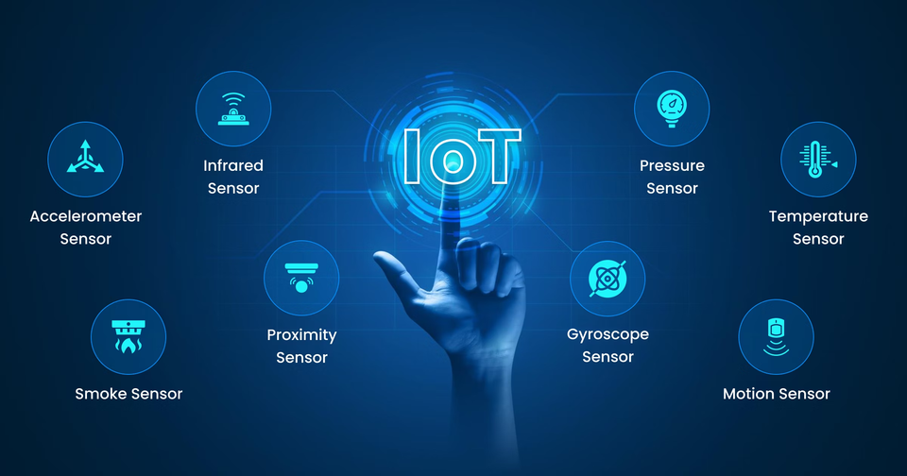
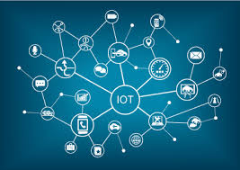
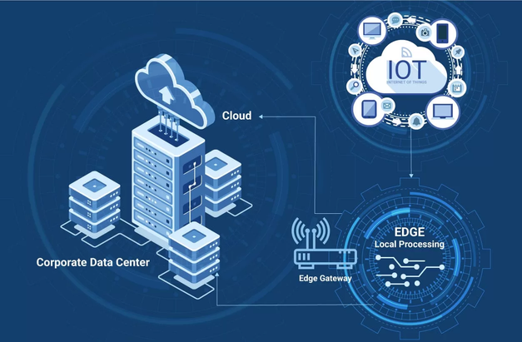
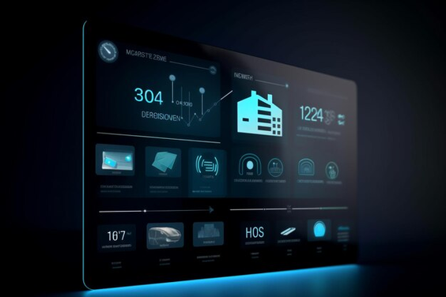
How IOT Works
Devices/Sensors
Connectivity
Data Processing
User Interface

Slide 7
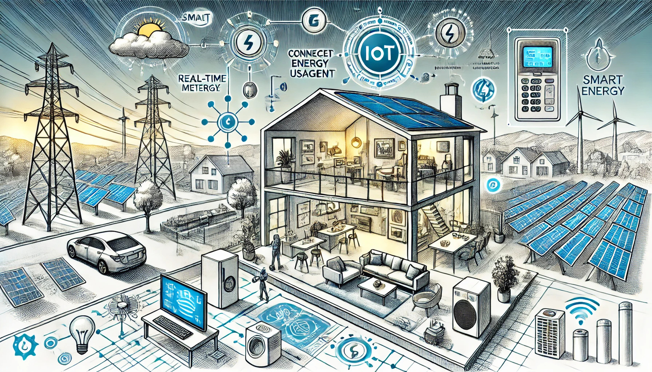
Future of IOT
Smart Cities
Healthcare Advancements

Slide 8


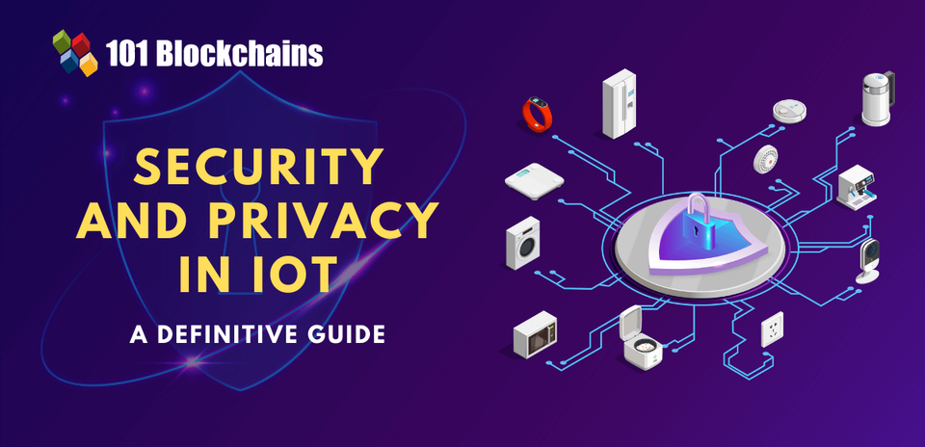
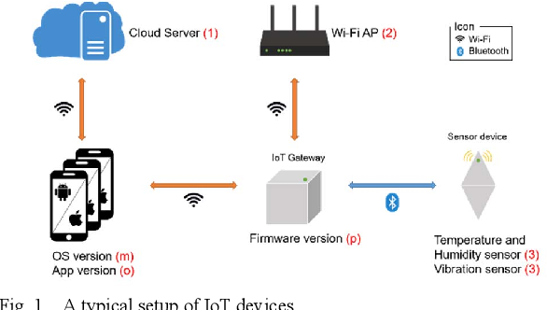


Challenges and Concerns
Security Risks
Privacy Issues
Compatibility
Cost

Slide 9
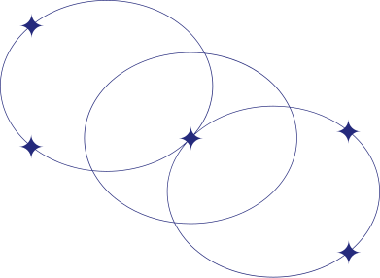
The world becomes more
intelligent and connected

